Slide 1

ENGLISH PREMIERE LEAGUE MATCH RESULTS How to build a betting strategy
ROLEX TEAM
Alexandre Lang, Joël Kuflom, Abdul Aloraib Alsalim & Alix Muller
Notes:
Hi everyone!
So today, with the Rolex Team, we will show you how to build a betting strategy ! To fulfil this goal, we will use a dataset containing English Premiere League Match Results. This dataset gives variables about the match statistics such as the referee, the number of shots etc, but also the Odds for each possible match results given by different betting websites.
What is an odd? I’ll show you

Slide 2
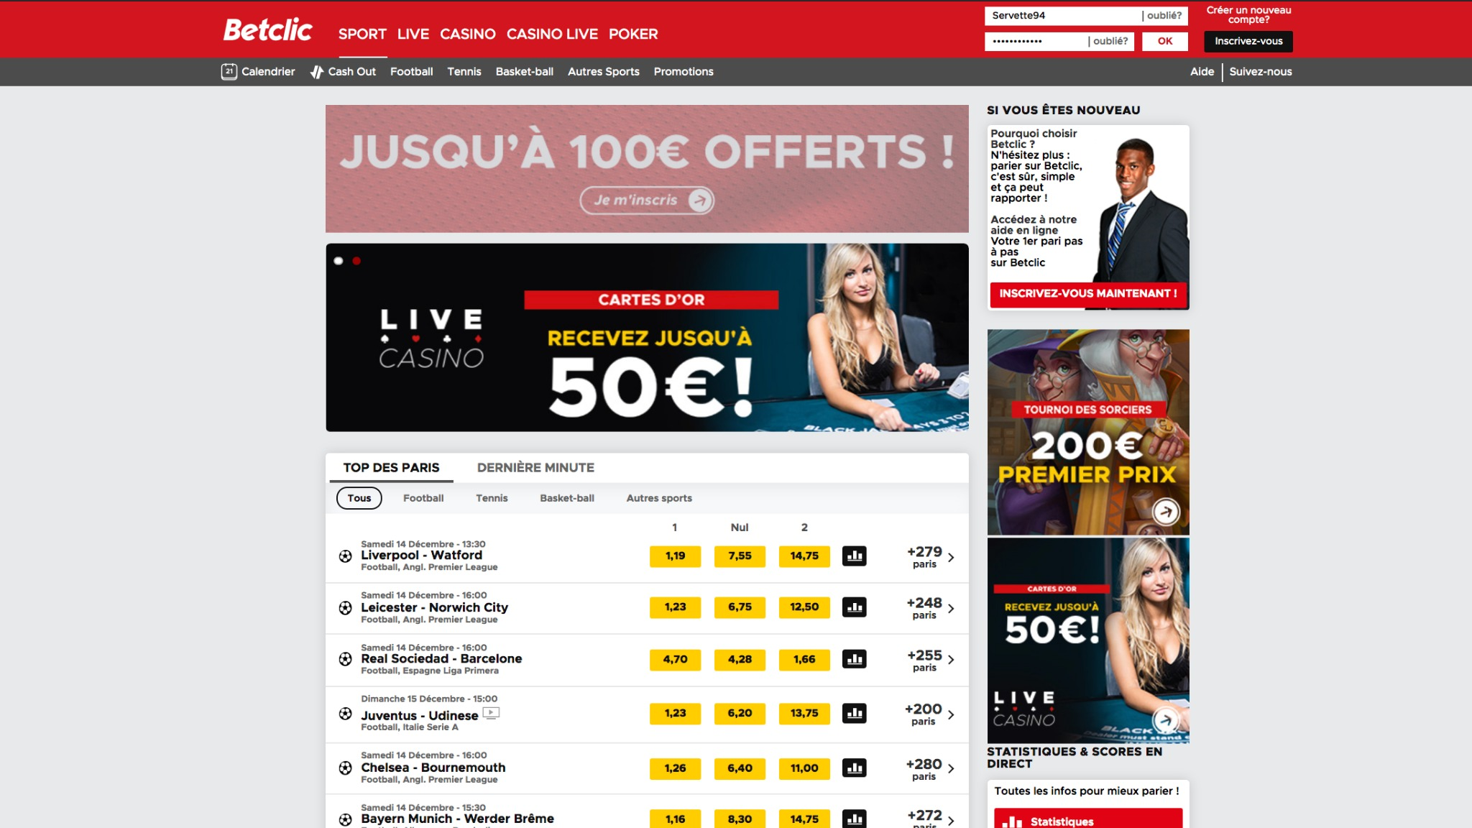
Notes:
So here Betclic, a betting website.

Slide 3
Notes:
It shows the teams and matches of last weekend.

Slide 4
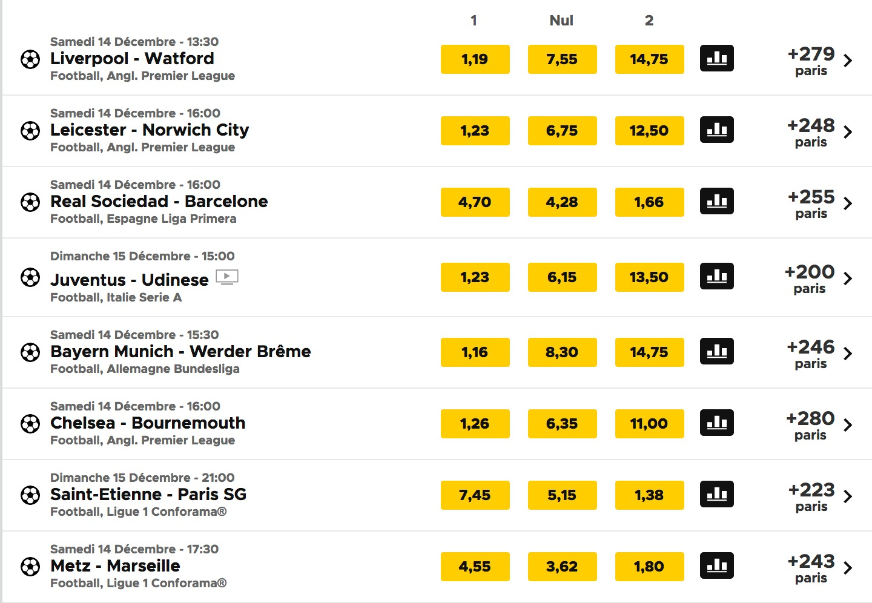
3 Odds
You can bet on one of these 3 results
Notes:
Let’s take the first match, it’s Liverpool against Watford.
You can see three columns showing 3 odds. It represents the possible match results:

Slide 5
Odd if
Liverpool wins
Notes:
1=Liverpool wins

Slide 6
Odd if
the match result is Draw
Notes:
Nul = Draw Match

Slide 7
Odd if
Watford wins
Notes:
2= Watford wins
So if you bet 100 francs on Watford, and they actually win => earn 1’475 !

Slide 8
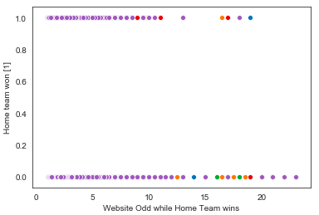
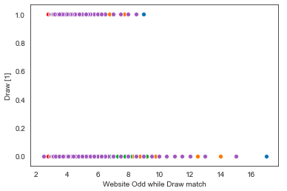
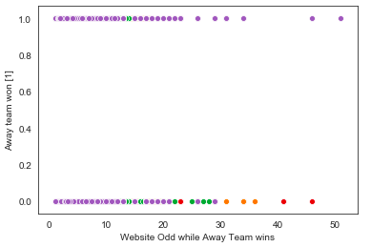
SCATTER PLOTS → Odds distribution Trends
Draw Match
Home Team WIN
Away Team WIN
Odd for Home win crossed with : 1 = Home WON 0 = Home did not WIN
Odd for Draw Match crossed with : 1 = Draw 0 = No Draw
Odd for Away win crossed with : 1 = Away WON 0 = Away did not WIN
Notes:
So you understood, there is 3 possible match results:
The Home team win, Draw match or Away team win. But this output is also a binary variable : the home team can actually win or NOT win.
These scatter plots crossed the Odds with the binary variable.
For example for home win : two distribution =>1 represents the odds that really realized themselves, so if the home team really won. And 0 is when the odd did not realized itself, so if the home team did not win.
There are odds from 1 to 25, and you can see that yes some people have seen their bet multiplied more that 15 times betting on the home team !
Draw match does not really happen, and betting on the away team... Sometimes people have won 50 times their initial bets !

Slide 9
THE METHODOLOGY for Classification
Logistic Regression
Odds
Match Statistics
One for...
Decision Trees
EQUATIONS
MODELS
VARIABLES
Home WINS Draw Away WINS
Odds
Match Statistics
Notes:
So, here we face a Classification problem and to build the best betting strategy possible, we need to find the most accurate model calculating the match result.
So in order to find it, we tried 2 different model: Logistric Regression and Decision Trees.
We will also used two set of independent variables to predict the match result : can we predict it by just using the odds? Or with just the match statistics?

Slide 10
THE BEST MODEL
Logistic Regression
Odds
Match Statistics
Decision Trees
EQUATIONS
MODELS
VARIABLES
X
Home WINS
X

Slide 11

BEST MODEL RESULTS W LOGISTIC REGRESSION WITH MATCH STATISTICS
Default rate
Accuracy
Precision
46%
69%
a
71%
Of Home teams
actually won
Of the predictions
were correct
Of True Positives over Actual Positives
When we say the Home team will win...
71%
really wins!

Slide 12

CONCLUSION W THE FINAL RESULTS OF THIS ANALYSIS
Complex to predict match results, however:
Better to use Match statistics over Odds → EMOTIONAL STIMULATION (NUMBERS)
Better to use Logistic Regression over Decision trees → MORE ACCURATE WHEN GOOD DISTRIBUTION
... with improvements and more variables,
this model could be used to build a prediction website!

Slide 13
THANK YOU

